Slide 1
Joining Datasets Part 1

Slide 2
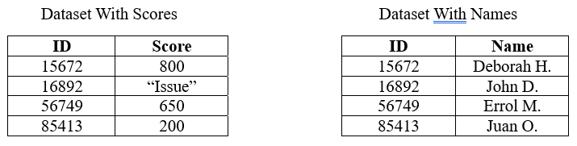
Example:

Slide 3
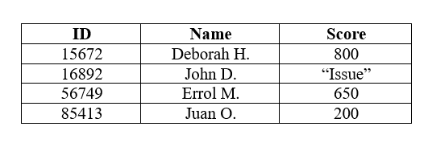

Slide 4
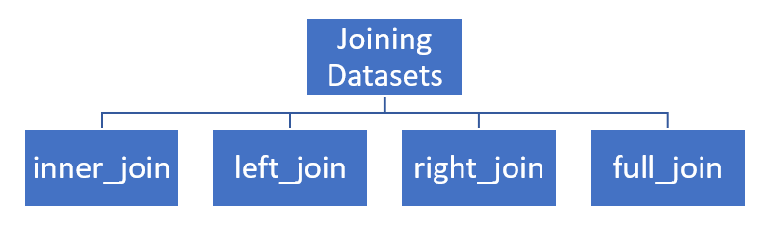

Slide 5
inner_join() Function
Command Illustration
new_dataframe_name <- dataframe_name_1 %>%
inner_join(dataframe_name_2, c("colname_1" = "colname_2"))

Slide 6
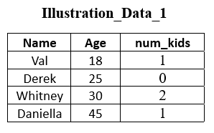
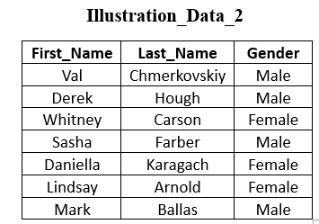

Slide 7
Example 1: Perform an inner join between Illustration_Data_1 and Illustration_Data_2
example_1 <- Illustration_Data_1 %>%
inner_join(Illustration_Data_2, c("Name" = "First_Name"))

Slide 8
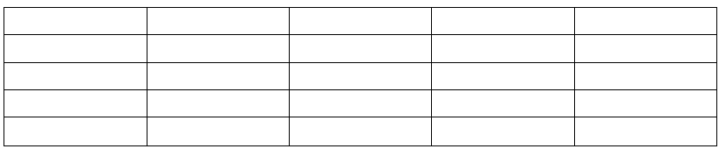
Output will be a dataframe that looks like:

Slide 9
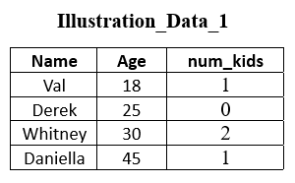
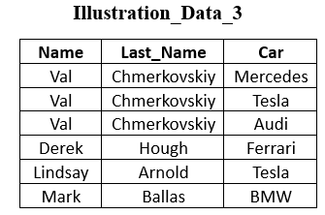

Slide 10
Example 2: Perform an inner join between Illustration_Data_1 and Illustration_Data_3
example_2 <- Illustration_Data_1 %>%
inner_join(Illustration_Data_3, c("Name" = "Name"))

Slide 11
Output will be a dataframe that looks like:

Slide 12
It is always a good idea to carefully check that the number of rows returned by a join operation is what you expected. In particular, you should carefully check for rows in one table that matched to more than one row in the other table.

Slide 13
Inspect the column by which you are joining.
nrow(Illustration_Data_1) Output:
n_distinct(Illustration_Data_1$Name) Output:
nrow(Illustration_Data_2) Output:
n_distinct(Illustration_Data_2$First_Name) Output:

Slide 14
Check how many data values from one dataset are in the other dataset.
table(Illustration_Data_1$Name %in% Illustration_Data_2$First_Name)
Output:
table(Illustration_Data_2$First_Name %in% Illustration_Data_1$Name)
Output:

